Slide 1
Display and backlight
Liang shih

Slide 2
Outline
Display/backlight schematic
Power on/Suspend/Resume
Display gamma
Backlight frequency
Automatic backlight control
DIMM/CABC

Slide 3
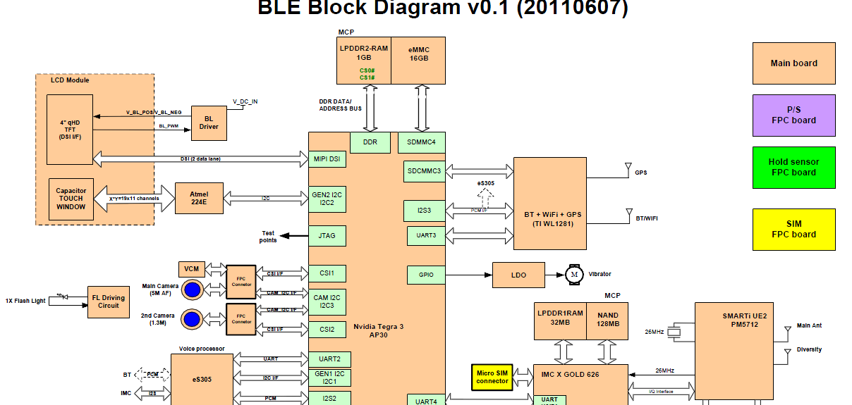

Slide 4
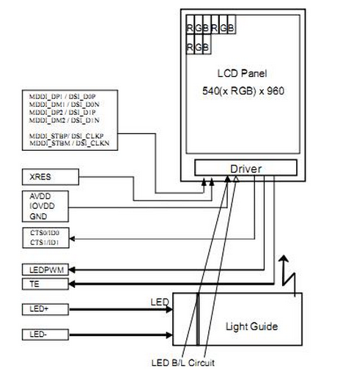
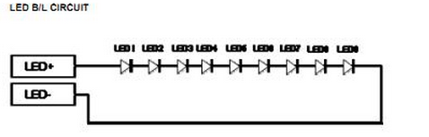
Display schematic

Slide 5
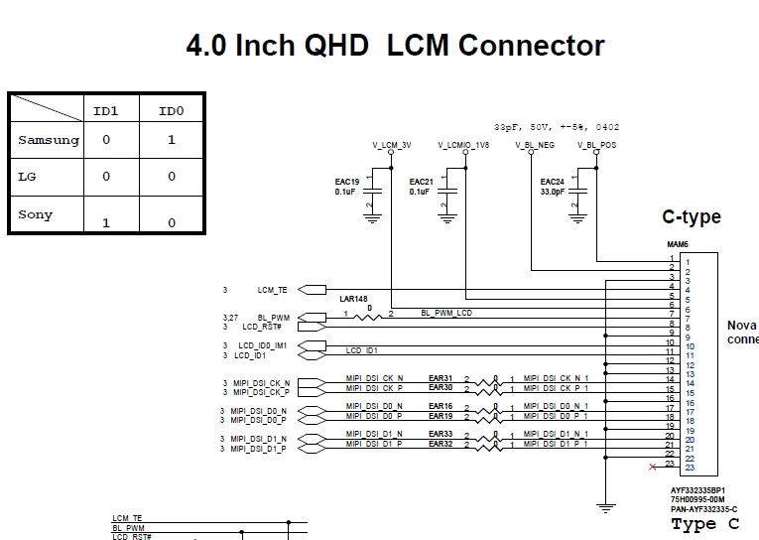
Display schematic

Slide 6
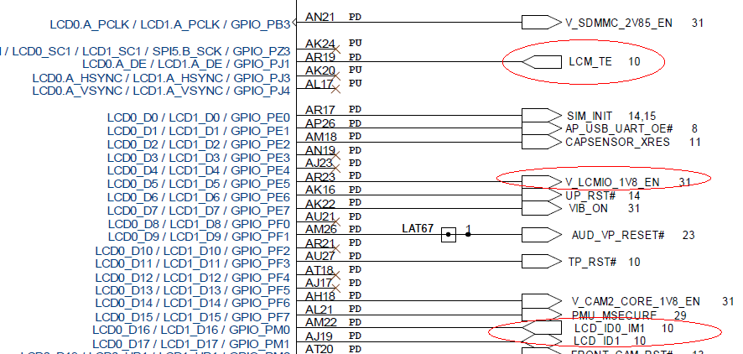
Display schematic

Slide 7
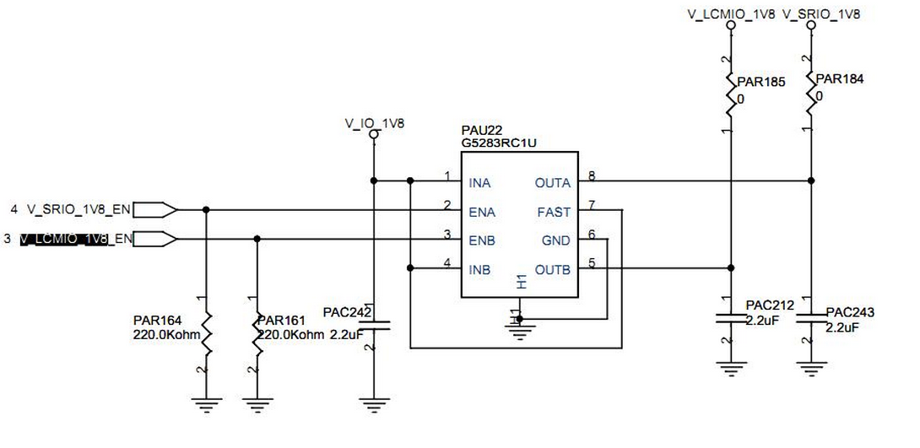
Display schematic

Slide 8
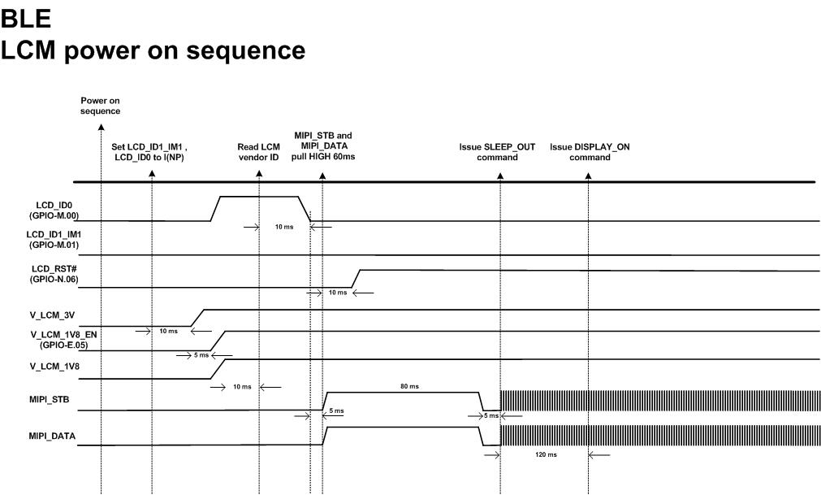
LCM power on sequence

Slide 9
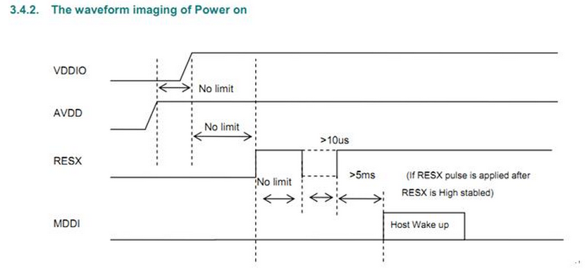
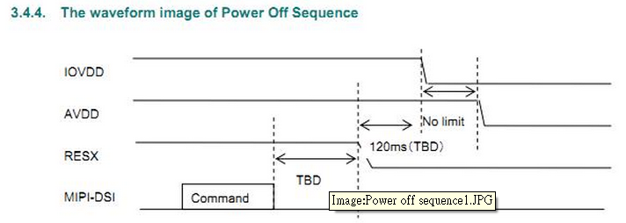
Suspend/resume Waveform

Slide 10
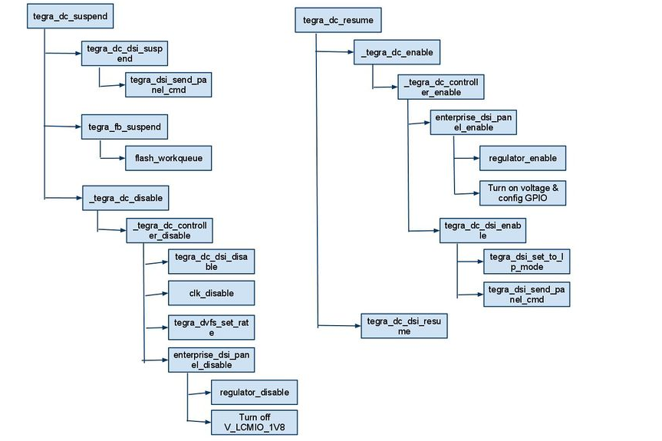
Suspend/resume flow

Slide 11
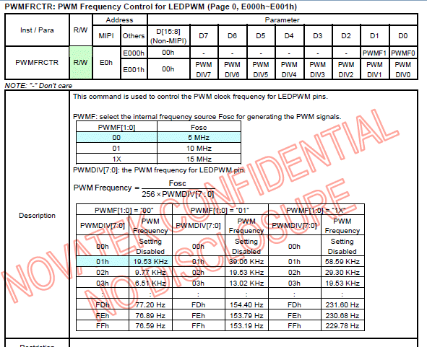


Backlight frequency

Slide 12
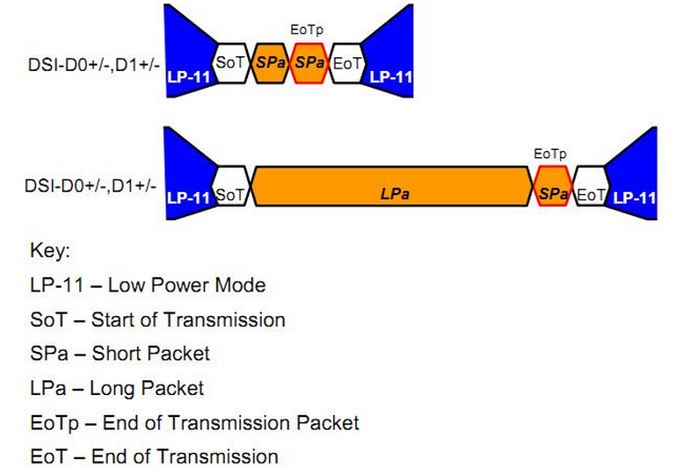
Short/Long packet
A transmission may consist of both short packets(SPa) and Long packets(LPa), it may contain only one packet or multiple packets.

Slide 13
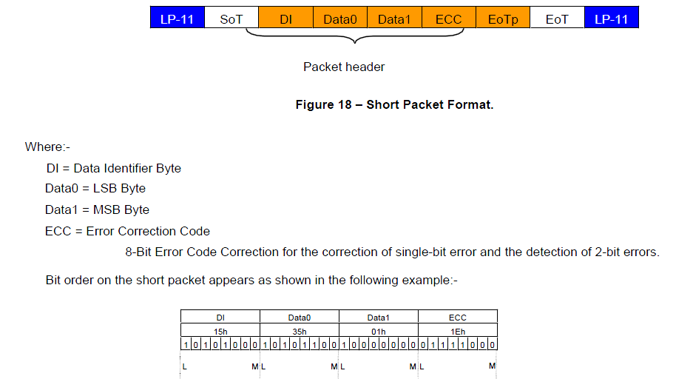
Short packet format

Slide 14
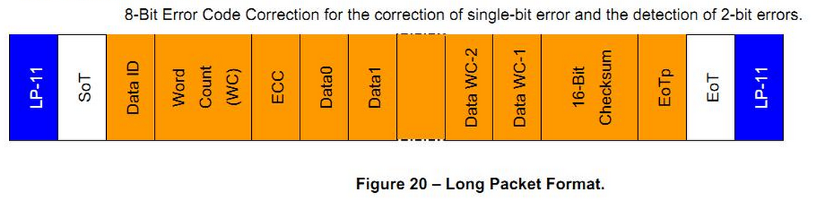
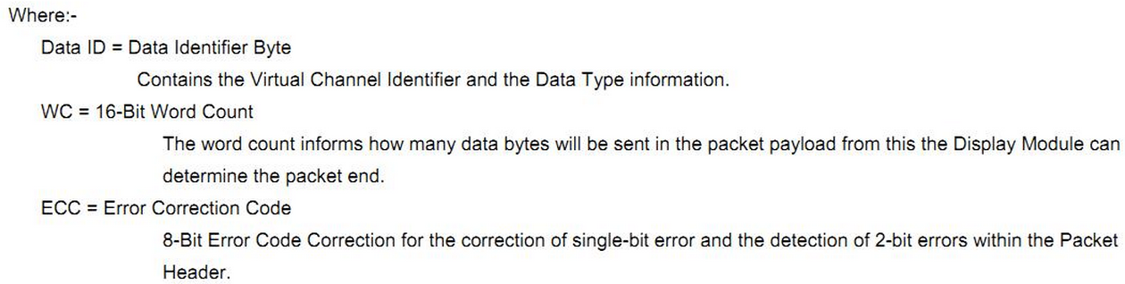
Long packet format

Slide 15
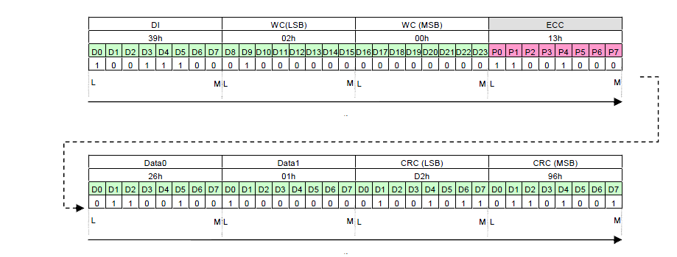
Long packet format

Slide 16
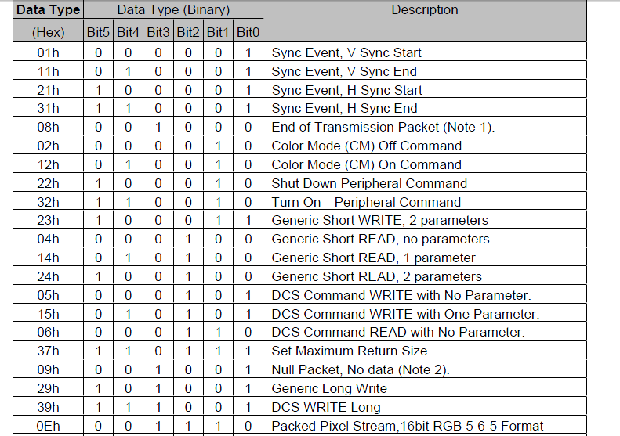

Slide 17
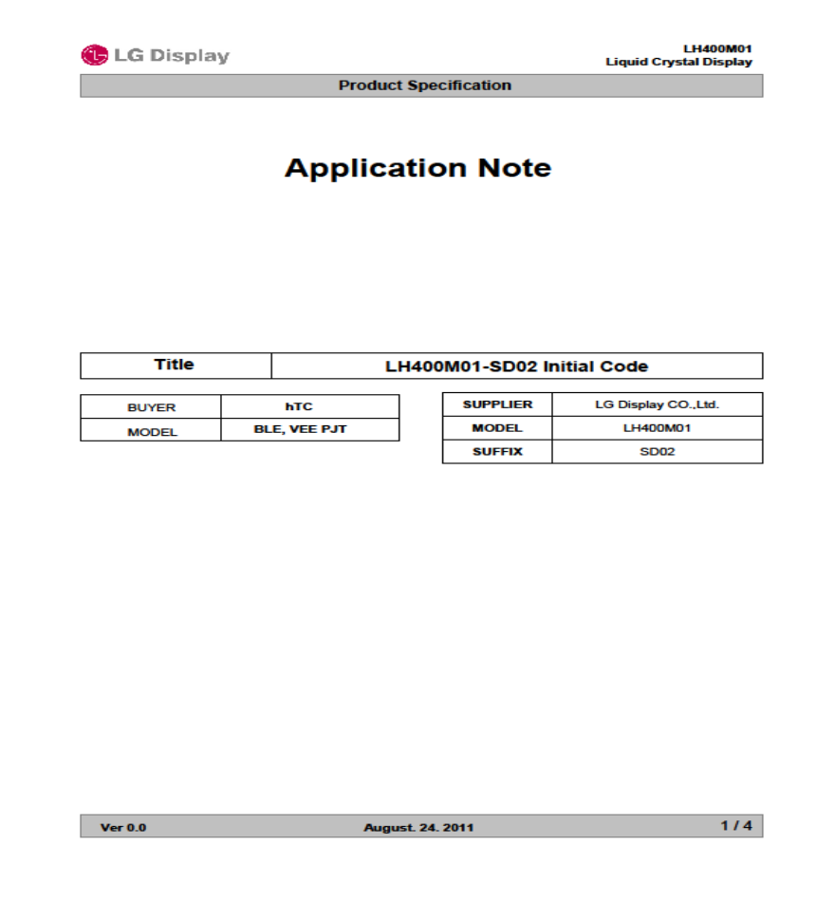
Display gamma
Gamma curve measured depends on accurate optics instruments

Slide 18
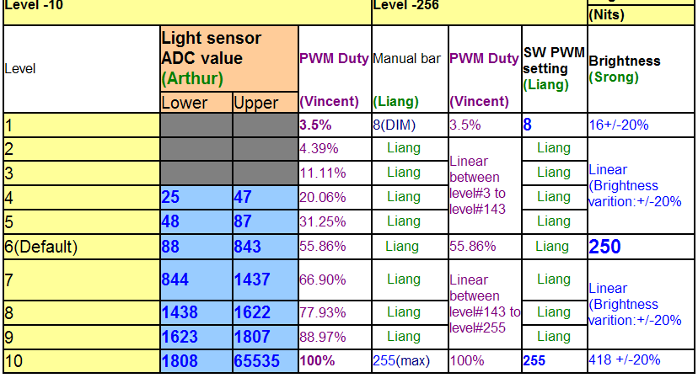
Auto backlight control
PWM:Pulse Width Modulation

Slide 19
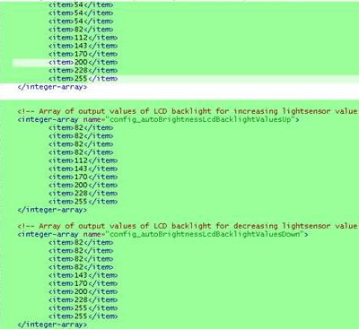
Auto backlight control
Brightness & light sensor definition:
File: framework\base\core\res\res\values\config.xml

Slide 20
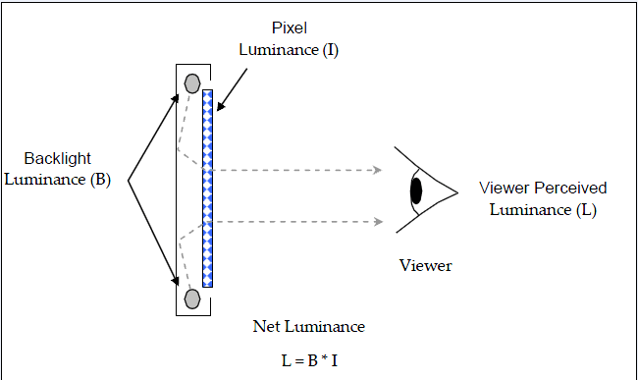
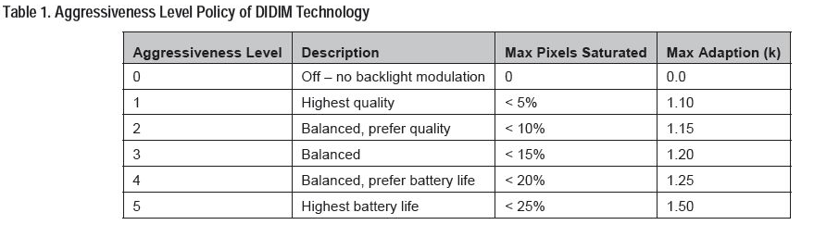
Smart dimmer
cd /sys/devices/nvhost/tegradc.0/smartdimmer

Slide 21
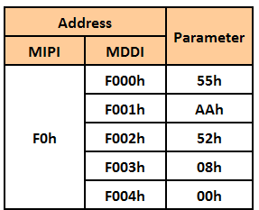
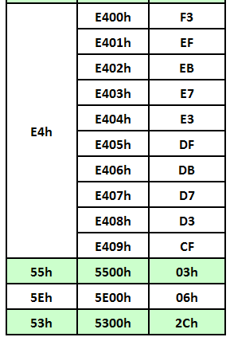
CABC
A Content Adaptive Brightness Control (CABC) function can be used to reduce the power consumption of the
luminance source.
CABC means that content grey level scale can be increased while decreasing brightness of the backlight to achieve same perceived brightness.

